Slide 1
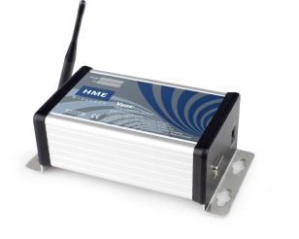
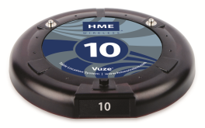
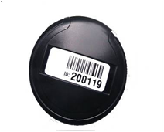
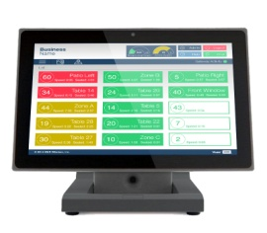
Easy Set-Up Instructions
Vuze ® Table Location System (PC Version)
Questions ? Phone: 800.919.9903, option 2 E-mail: hmewsupport@hme.com
VUZE SYSTEM
Step 1 – Connect Vuze Reader The Vuze reader requires a direct connection to the internet to provide updates via the web. Prior to shipment, HME worked with your IT contact to ensure that the reader was configured for your location. Installation should be as simple as connecting the reader to your network router via the supplied Cat5(e) network cable and plugging in the power supply. Please consult your IT contact if you are unsure of the exact location of the network router.
Step 2 – Charge Guest Coaster Tags The Guest Coaster Tags stack vertically on round chargers. Each charger can support up to 15 tags. Once all tags have been placed, typically around the register area, connect the power supplies to the charger and plug into a standard wall outlet. Once plugged in, the coasters will begin charging as indicated by the red LED light on each tag. Coasters should be up to a full charge within two hours.
Step 3 – Reference Tags Reference Tags mark specific locations within a restaurant. Prior to shipment, HME worked with the restaurant management to ensure that all of the locations that needed to be marked were. Each reference tag is labeled with a sticker that corresponds to a location on the floor map provided in the box. Place all reference tags in the marked locations. ***DO NOT MOUNT TAGS UNTIL AFTER THE INITIAL TESTING DESCRIBED IN THE MANUAL*** Once testing has been completed, attach all reference tags to the tables or items at their marked locations using the supplied screws or plastic ties.
Step 4 – Vuze PC and Software The Vuze PC that you purchased includes all of the required software needed and will load automatically when turned on. Prior to shipment, HME tested all of your hardware with the PC to ensure that everything was completely set up and ready to go for you. Vuze is designed to run locally with the ability to push data to our cloud server (if online) for above store reporting. If online, your Vuze PC will also look for any updates that have been performed and install them after hours.
QUICK TIPS
A surge protector is recommended for all products. Coaster Tags can maintain a charge for 12 - 15 hours. Do not stack more than 15 coasters on a charger to ensure proper charging. The reader should be positioned or mounted at a minimum of 4 – 6 feet off the ground, away from metal with the antenna pointing upward. Reference tags should be mounted in the middle of tables when possible. Avoid direct contact with table legs as they will deflect the signals. Coaster tags appear and disappear on screen based on hearing an “activate” or “deactivate” tag. Coasters need to hear this tag 2x in a row to register an update (approx. 10 seconds). When moving tags between the collection bin and the registers, make sure to take the entire bin to avoid phantom records appearing on screen. A coaster is a sleep when on a charger. Make sure it has time to hear the reference tag nearest the register (approx 10 seconds) before handing to guest or placing back on the charger.
VUZE READER
GUEST COASTER TAG
REFERENCE TAG
VUZE SOFTWARE

